Slide 1
WHAT IS METAVERSE?

Slide 2

Hello!
I AM Hussain Burhanuddin
I am here to present on the topic “Metaverse” and to make you understand this technology.

Slide 3
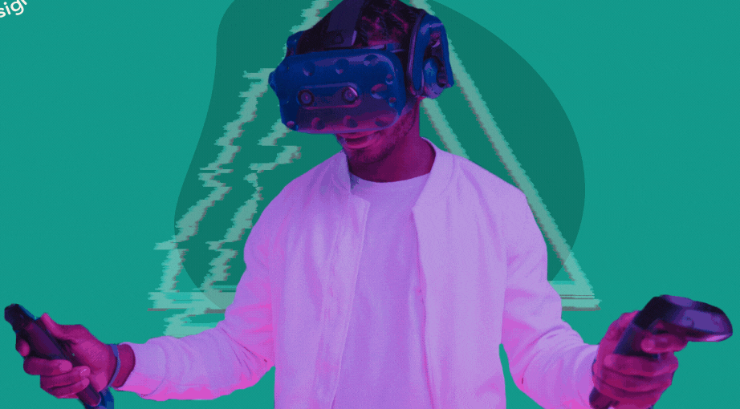
INTRODUCTION
1
An Explanation for People Who Don’t Get It.

Slide 4
The metaverse is a 3D version of the Internet and computing at large.

Slide 5
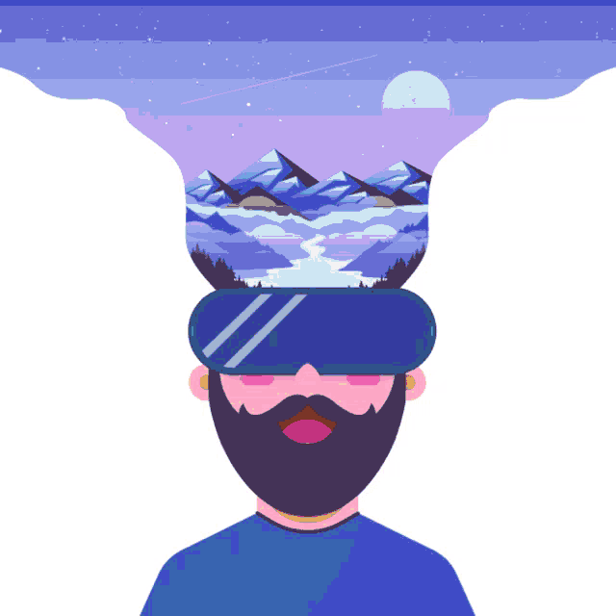
WHAT EXACTLY IS THE METAVERSE?
Talking about the metaverse feels a lot like talking about the internet back in the 70s and the 80s.
As the building blocks of the new form of communication were being laid down, it sparked speculation around what it would look like and how people would use it.

Slide 6
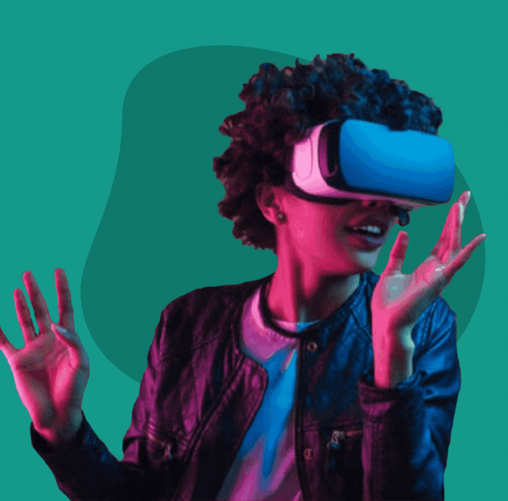
WHAT EXACTLY IS THE METAVERSE?
Many experts look at the metaverse as a 3D model of the internet.
Basically, a place parallel to the physical world, where you spend your digital life.
A place where you and other people have an avatar, and you interact with them through their avatars.
Some also argue that the metaverse in the truest sense of the term doesn’t actually exist yet.

Slide 7
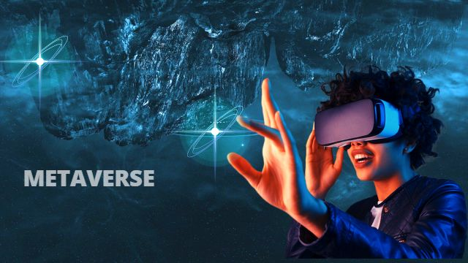
WHAT EXACTLY IS THE METAVERSE?
While the discourse on defining the metaverse differs from case to case, it is, in the simplest terms, a shared virtual space that is interactive, immersive and hyper-realistic.
It would also include your own customized avatar and digital assets, which will likely be recorded on a blockchain.

Slide 8
History of Metaverse
2
How it started

Slide 9
A Brief History of Metaverse
THE TERM “METAVERSE” WAS COINED BY AUTHOR Neal Stephenson in his 1992 novel Snow Crash. he described was a persistent virtual world that reached, interacted with, and affected nearly every part of human existence. It was a place for labor and leisure, for self-actualization as well as physical exhaustion, for art alongside commerce.
Stephenson’s novel was an inspiration for the developments such as :
Blue Origin,
Google Earth,
Cryptocurrency,
Decentralized Computer Networks,
CGI
VR Headsets

Slide 10
Metaverse Development Timeline
Multi User Dungeons
Multi User Shared Hallucinations
Multi User Experiences
Web Worlds
Active Worlds
OnLive
1950s
1980s
2000s
1970s
1990s
Proto Metaverses
Habitat
Pac-Man
Super Mario Bros
Avatars
Second Life
Roblox

Slide 11
Metaverse Development Timeline
Adopt me
Fortnite
Travis Scott concert on Fortnite
2011
2018
2022
2017
2020
Minecraft
Fortnite Creative Mode
Facebook to Meta

Slide 12
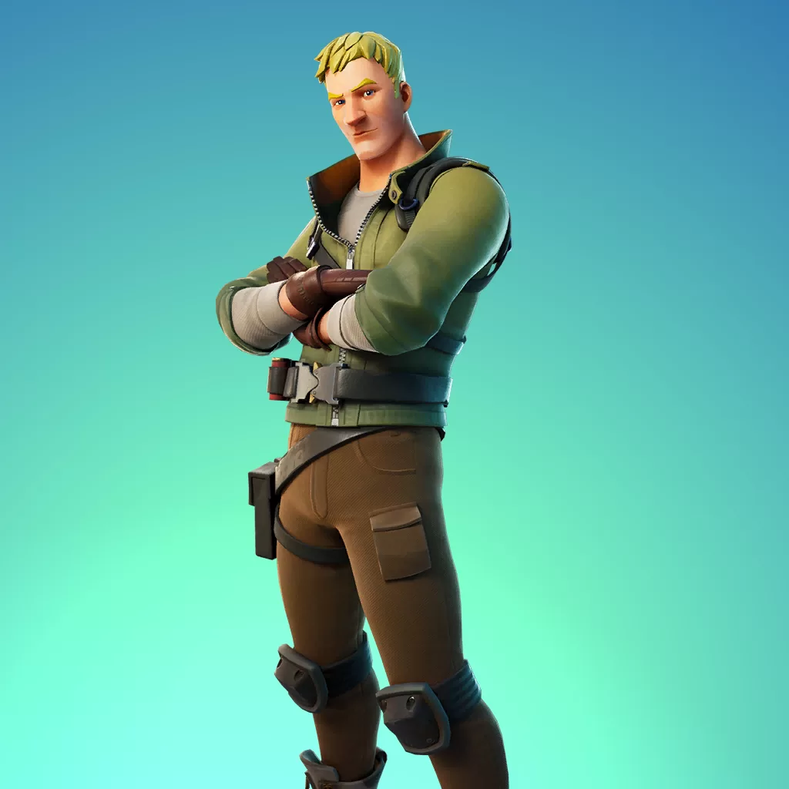
IT’S NOT JUST A GAME?
FORTNITE
Take for instance an online shooter game like Fortnite, where users have a personal avatar to engage and interact with other players' avatars, while also earning virtual currency to unlock outfits for their avatar.

Slide 13

IT’S NOT JUST A GAME?
SECOND LIFE
Perhaps the closest existing iteration to the envisioned metaverse is the game Second Life, a simulation game that lets users experience virtual reality in which their avatar could shop, eat, shower, and do everything they would in real life.

Slide 14
Confusion and Uncertainty
3
Does everyone have the same idea of Metaverse?

Slide 15
Does everyone have the same idea of Metaverse?
METAVERSE, the term has no consensus definition. Most industry leaders define it in the manner that fits their own worldviews and/or the capabilities of their companies. For example, Microsoft’s CEO Satya Nadella has described the Metaverse as a platform that turns the “entire world into an app canvas”
Mark Zuckerberg’s articulation focused on immersive virtual reality as well as social experiences that connect individuals who live far apart.
Epic’s vision of the Metaverse, is of “an expansive, digitized communal space where users can mingle freely with brands and one another in ways that permit self-expression and spark joy . . . a kind of online playground where users could join friends to play a multiplayer game like Epic’s ‘Fortnite’ one moment, watch a movie via Netflix the next.

Slide 16
What is Metaverse
4
Finally a definition

Slide 17
“A massively scaled and interoperable network of real-time rendered 3D virtual worlds that can be experienced synchronously and persistently by an effectively unlimited number of users with an individual sense of presence, and with continuity of data, such as identity, history, entitlements, objects, communications, and payments.”

Slide 18
Breaking down the definition
5
What does it mean?

Slide 19

What is Virtual Reality
Virtual worlds refer to any computer-generated simulated environment. These environments can be in immersive 3D, 2.5D (also known as isometric 3D), 2D, layered atop the “real world” via augmented reality, or purely text-based
Stylistically, virtual worlds can reproduce the “real world” exactly (these are often called a “digital twin”) or represent a fictionalized version of it or represent an altogether fictional reality in which the impossible is commonplace.

Slide 20
What is Real-Time Rendering?
Rendering is the process of generating a 2D or 3D object or environment using a computer program. The goal of this program is to “solve” an equation made up of many different inputs, data, and rules that determine what should be rendered (that is, visualized)

Slide 21
What is Interoperable Network?
“Interoperable,” a term that refers to the ability for computer systems or software to exchange and make use of information sent from one another
Central to most visions of the Metaverse is the user’s ability to take her virtual “content,” such as an avatar or a backpack from one virtual world to another, if I buy an outfit in Minecraft I might then wear it in Roblox, or perhaps a hat I purchased in Minecraft would be paired with a sweater I won in Roblox while attending a virtual sporting match developed and operated by FIFA.

Slide 22
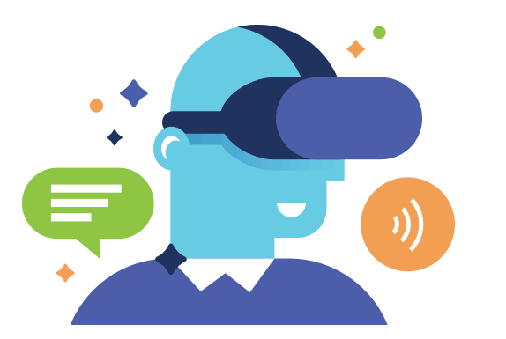
PLATFORMS
6
How do I access the metaverse for now?

Slide 23


HOW DO I ACCESS THE METAVERSE FOR NOW?
While there is no single gateway to access the metaverse at this point, experts suggest acquiring some hardware to truly immerse yourself in the experience.
In turn, this has led to multiple tech heavyweights offering a variety of experiences, from gaming and virtual workspaces to live entertainment and real estate. This includes platforms like Decentraland, Axie Infinity, Horizon, Sandbox, Fortnite and Roblox.

Slide 24
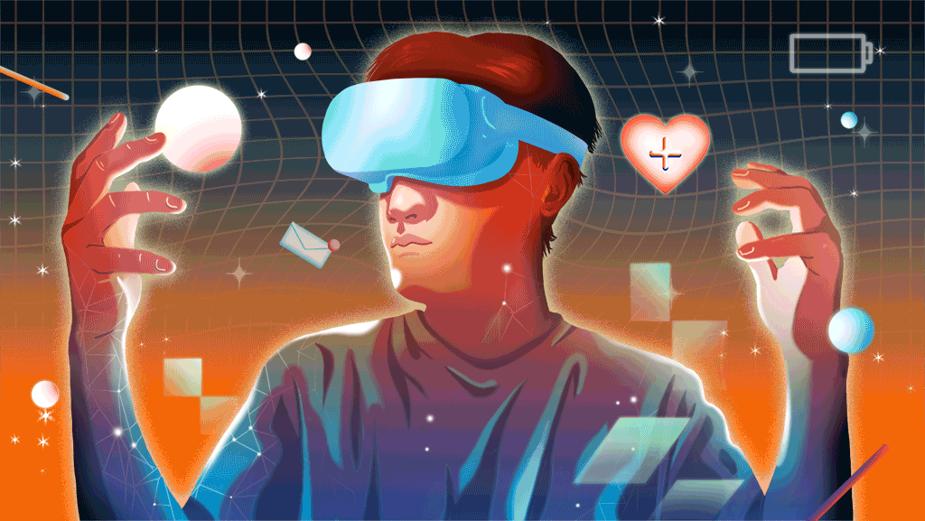
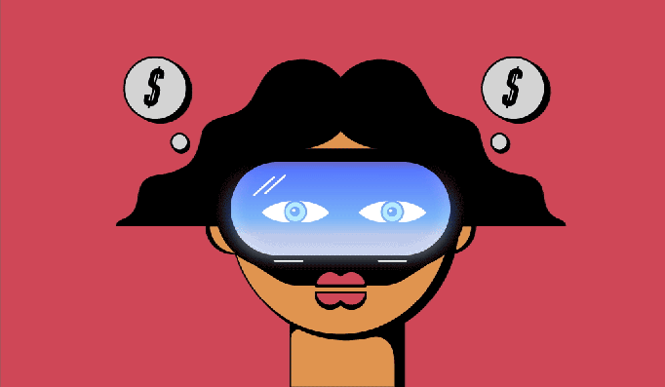
HOW DO I ACCESS THE METAVERSE FOR NOW?
However, many experts also argue that you don’t necessarily need a VR headset to get into the metaverse.
We’ll access the metaverse via a smartphone, but we will often be passively in it. There are hundreds of millions of people accessing real-time rendered 3D virtual worlds each day via tablets and smartphones. In a decade, it’s likely these devices will remain the primary way we access the metaverse.

Slide 25
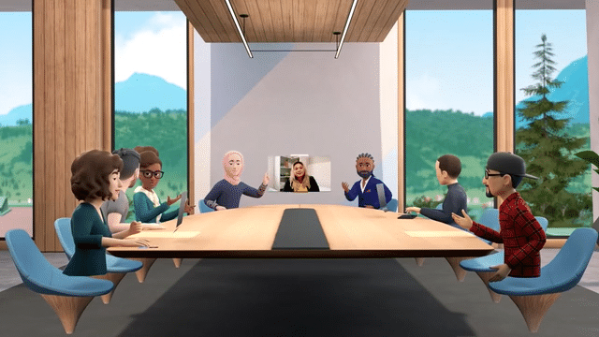
BENEFITS
7
What is the use of the Metaverse, really?

Slide 26
WHAT IS THE USE OF THE METAVERSE, REALLY?
The metaverse will grow the digital economy, which is the primary growth driver of the world economy.
But while the metaverse is already being seen as the future of entertainment, fashion, gaming and even partying, experts argue that its best-case use will likely be for education.
Just like how you'd understand dissection much better by actually performing it rather than just reading about it, 3D-based education is likely to be much better than, say, schooling over Zoom.

Slide 27
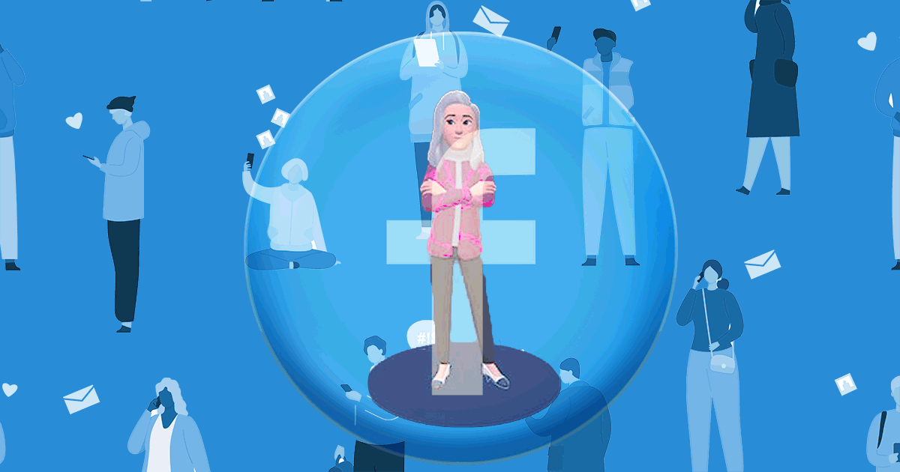
WHAT IS THE USE OF THE METAVERSE, REALLY?
Buying virtual countries that don’t exist in the real world could be an investment opportunity for making a quick buck, but the real value of the metaverse is when it’ll be used in ways that bring value to people’s lives.
So while there are scenarios where the technology and implementation can be useful – such as an augmented reality setup to train car mechanics or to help someone remotely fix an elevator they are stuck in – it still needs some work.

Slide 28

RISKS
8
Is it safe to be in the Metaverse?

Slide 29
IS IT SAFE TO BE IN THE METAVERSE?
Digital privacy experts also continue to point out that the metaverse would be the ultimate surveillance tool.
Not only would the metaverse collect data on your eye-tracking movement, hand movements, the shape of your room and more.
We also have to figure out a legal framework of what happens if you get harassed in a virtual platform, given that it has real implications since you’re so immersed in the technology.

Slide 30
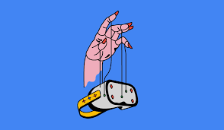
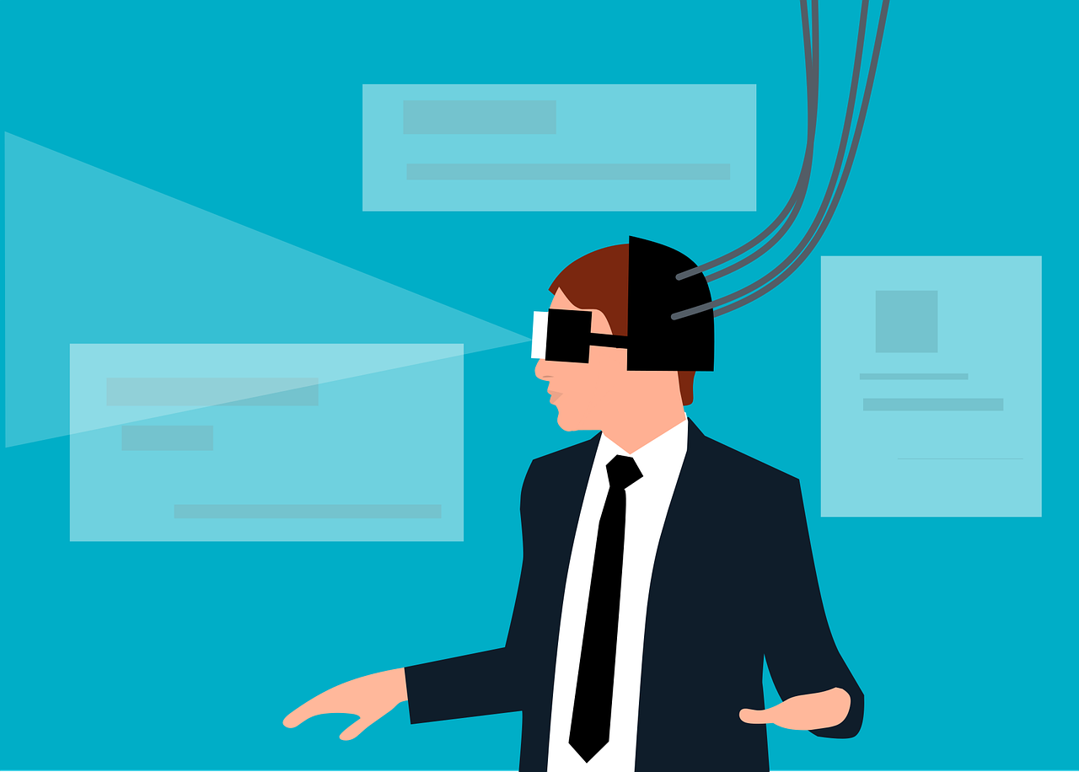
IS IT SAFE TO BE IN THE METAVERSE?
The metaverse, he added, presupposes an implicit trust in technology, the way we rely on Google Maps for directions even if we’re never really sure whether it will lead us to the right destination.
There’s all this legal stuff we have to think about and actively pursued if we want to responsibly develop these technologies.

Slide 31
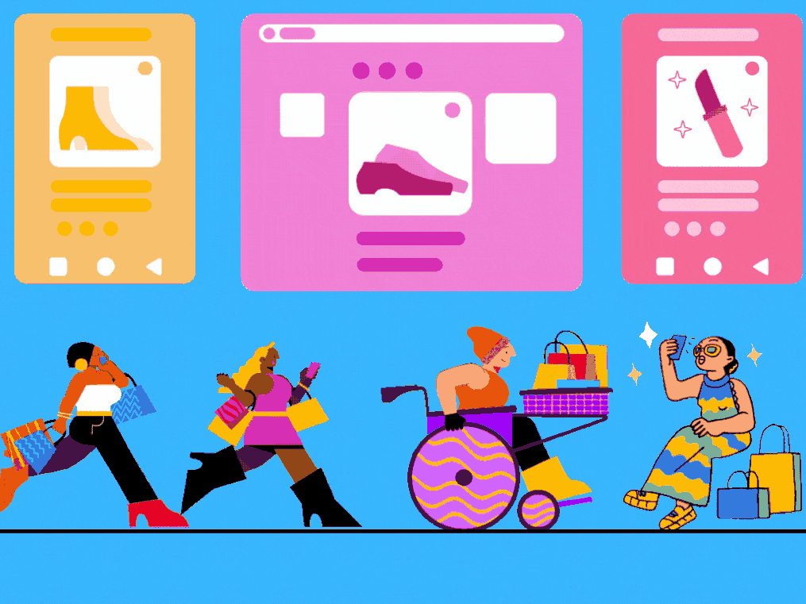
FUTURE
9
Will I be living in the Metaverse some years from now?

Slide 32
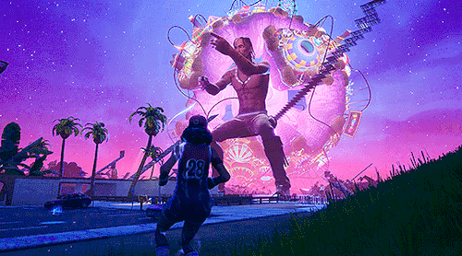
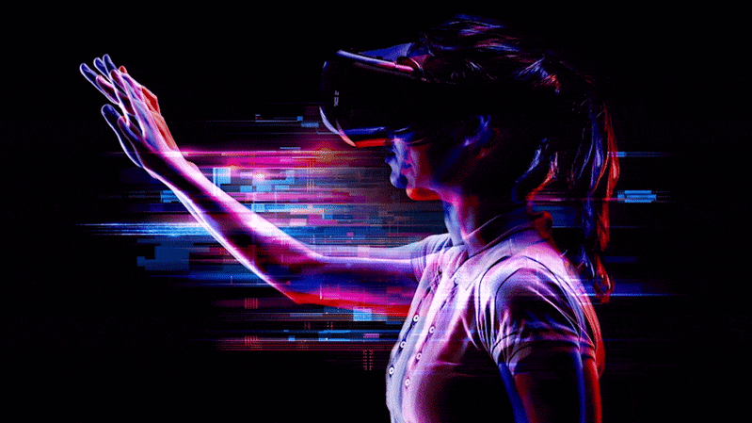
WILL WE BE LIVING IN THE METAVERSE SOME YEARS FROM NOW?
Some experts believe a large proportion of people will be in the metaverse in some way by 2030.
Perhaps we’ll live in the metaverse intermittently – we enjoy putting on VR goggles but don’t keep them on for very long.
Or, maybe, we’ll laugh at this VICE article a decade from now, thinking how naive people were to have questioned the rise of the metaverse.

Slide 33

THANK YOU!
Any Questions?

